Slide 1
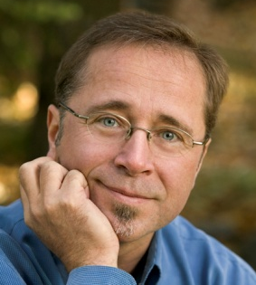

Welcome UBC Students
SEMINAR: My Global Career Skills with Jean-Marc Hachey &
UBC Sauder School of Business
Please register BEFORE the start of this seminar for your FREE 12-month subscription to “The BIG Guide Online”
STEP ONE: Register at
www.WorkingOverseas.com/ubc
CAUTION: You must use your UBC student
e-mail address (your-name@exchange.ubc.edu)
STEP TWO: Go to your e-mail account and retrieve
the activation e-mail we have sent you.
FUTURE LOGINS, go to top of page at
www.WorkingOverseas.com

Slide 2
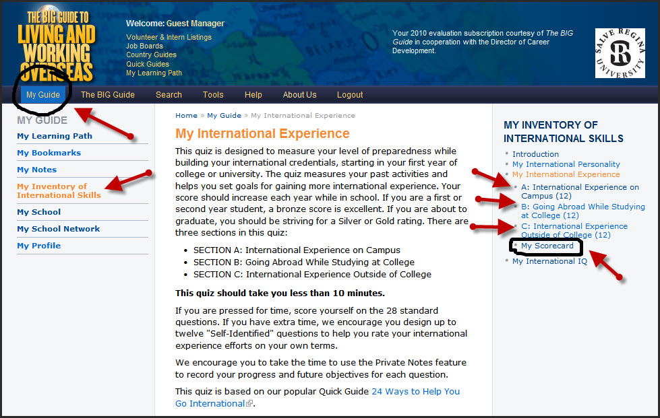
3 Quizzes “My International Experience”

Slide 3
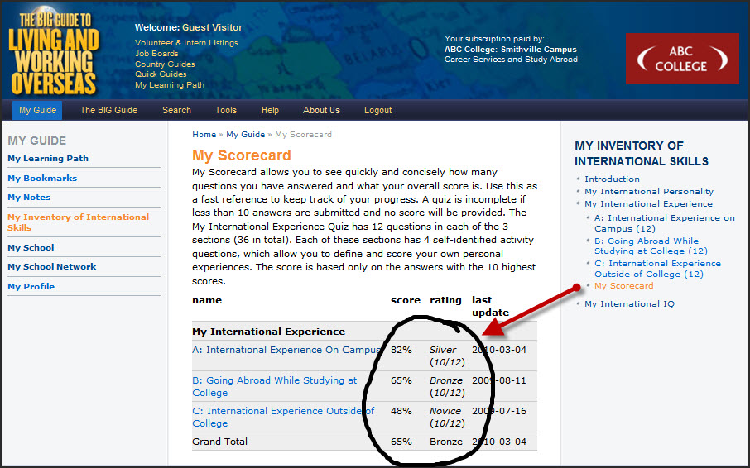
My Scorecard: “My International Experience”

Slide 4
WORKSHOP: My International Experience
Paired Discussion Questions
What two strategies could you undertake to gain international experience (build your global career skills) during the next six months?
One of your two strategies must be about how to gain international experience on campus.
Duration: five minutes

Slide 5

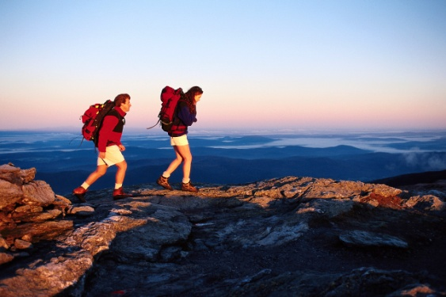



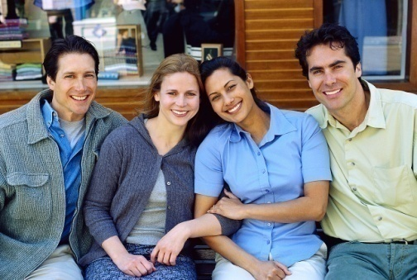
How To Acquire International Experience
At Home While Studying At University
Study something international
Join multiethnic student work teams
Target foreign students
Going Abroad While Studying At University
Study at least one semester abroad
Apply for international scholarships
Take a gap year off to travel abroad
Gain Professional Experience After Graduation
Teach English overseas
Intern abroad
Extend your stay abroad
with junior consulting work
Join international clubs
Network internationally
Develop your international IQ
Join short term volunteer program
Attend international conferences
Network while overseas
Learn another language
Backpack for six months
Professional experience
while traveling

